Slide 1


CEVA-XM4™
DDMA
User Guide
Rev. 1.0
June 2016
DSP Division
CONFIDENTIAL • UNAUTHORIZED REPRODUCTION PROHIBITED

Slide 3

Documentation Control
Documentation Control
History Table
Version | Date | Description | Remarks
1.0 | 8 June 2016 | Initial version
Confidential and Proprietary · Unauthorized Reproduction Prohibited
Copyright © 2016 – CEVA®, Inc.
i

Slide 4
CEVA-XM4™ DDMA User Guide
Disclaimer and Proprietary Information Notice
The information contained in this document is subject to change without notice and does not represent a commitment on any part of CEVA®, Inc. CEVA®, Inc. and its subsidiaries make no warranty of any kind with regard to this material, including, but not limited to implied warranties of merchantability and fitness for a particular purpose whether arising out of law, custom, conduct or otherwise.
While the information contained herein is assumed to be accurate, CEVA®, Inc. assumes no responsibility for any errors or omissions contained herein, and assumes no liability for special, direct, indirect or consequential damage, losses, costs, charges, claims, demands, fees or expenses, of any nature or kind, which are incurred in connection with the furnishing, performance or use of this material.
This document contains proprietary information, which is protected by U.S.
and international copyright laws. All rights reserved. No part document may be reproduced, photocopied, or translated into language without the prior written consent of CEVA®, Inc.
CEVA®, CEVA-XC™, CEVA-XC5™, CEVA-XC321™, XC323™, CEVA-XC8™, CEVA-Xtend™, CEVA-XC4000™,
of this another
CEVA- CEVA-
XC4100™, CEVA-XC4200™, CEVA-XC4210™, CEVA-XC4400™,
CEVA-XC4410™, CEVA-XC4500™, CEVA-XC4600™,
CEVA- CEVA-
TeakLite™, CEVA-TeakLite-II™, CEVA-TeakLite-III™,
TL3210™, CEVA-TL3211™, CEVA-TeakLite-4™, CEVA-TL410™, CEVA-TL411™, CEVA-TL420™, CEVA-TL421™, CEVA-Quark™, CEVA-Teak™, CEVA-X™, CEVA-X1620™, CEVA-X1622™, CEVA-
X1641™, CEVA-X1643™, Xpert-TeakLite-II™, Xpert-Teak™, CEVA- XS1100A™, CEVA-XS1200™, CEVA-XS1200A™, CEVA-TLS100™, Mobile-Media™, CEVA-MM1000™, CEVA-MM2000™, CEVA-SP™,
CEVA-VP™, CEVA-MM3000™, CEVA-MM3100™,
CEVA- CEVA-
MM3101™, CEVA-XM™,
CEVA-XM4™,
CEVA-X2™,
Audio™, CEVA-HD-Audio™, CEVA-VoP™, CEVA-Bluetooth™, CEVA-SATA™, CEVA-SAS™, CEVA-Toolbox™, SmartNcode™ are trademarks of CEVA, Inc.
All other product names are trademarks or registered trademarks of their respective owners.
ii
Confidential and Proprietary · Unauthorized Reproduction Prohibited
Copyright © 2016 – CEVA®, Inc.

Slide 5
Support
Support
CEVA® makes great efforts to provide a user-friendly software and hardware development environment. Along with this, CEVA provides comprehensive documentation, enabling users to learn and develop applications on their own. Due to the complexities involved in the development of DSP applications that might be beyond the scope of the documentation, an online Technical Support Service has been established. This service includes useful tips and provides fast and efficient help, assisting users to quickly resolve development problems.
How to Get Technical Support:
FAQs: Visit our website http://www.ceva-dsp.com or your company’s protected page on the CEVA website for the latest answers to frequently asked questions.
Application Notes: Visit our website http://www.ceva-dsp.com or your company’s protected page on the CEVA website for the latest application notes.
Email: Use the CEVA central support email address ceva- support@ceva-dsp.com. Your email will be forwarded automatically to the relevant support engineers and tools developers who will provide you with the most professional support to help you resolve any problem.
License Keys: Refer any license key requests or problems to sdtkeys@ceva-dsp.com. For SDT license keys installation information, see the SDT Installation and Licensing Scheme Guide.
Email: ceva-support@ceva-dsp.com
Visit us at: www.ceva-dsp.com
Confidential and Proprietary · Unauthorized Reproduction Prohibited
Copyright © 2016 – CEVA®, Inc.
iii

Slide 6
CEVA-XM4™ DDMA User Guide
List of Sales and Support Centers
Israel | USA | Ireland | Sweden
2 Maskit Street | 1174 Castro Street | Segrave House | Klarabergsviadukten
P.O. Box 2068 | Suite 210 | 19/20 Earlsfort Terrace | 70 Box 70396 107 24
Herzelia 46120 | Mountain View, CA | 3rd Floor | Stockholm
Israel | 94040 | Dublin 2 | Sweden
 | USA | Ireland
Tel: +972 9 961 3700 | Tel: +1-650-417-7923 | Tel: +353 1 237 3900 | Tel: +46(0)8 506 362 24
Fax: +972 9 961 3800 | Fax: +1-650-417-7924 | Fax: +353 1 237 3923 | Fax: +46(0)8 506 362 20
China (Shanghai) | China (Beijing) | China (Shenzhen) | Hong Kong
Unit 1203, Building E | Rm 503, Tower C | Rm 709, Tower A | Level 43, AIA Tower
Chamtime Plaza Office | Raycom InfoTech Park | SCC Financial Centre | 183 Electric Road
Lane 2889, Jinke Road | No. 2, Kexueyuan South | No. 88 First Haide | North Point
Pudong New District | Road | Avenue | Hong Kong
Shanghai, 201203 | Haidian District | Nanshan District
China | Beijing 100190 | Shenzhen 518064
 | China | China
Tel: +86-21-20577000 | Tel: +86-10-5982 2285 | Tel: +86-755-8435 6038 | Tel: +852-39751264
Fax: +86-21-20577111 | Fax: +86-10-5982 2284 | Fax: +86-755-8435 6077
South Korea | Taiwan | Japan | France
#478, Hyundai Arion | Room 621 | 1-6-5 Shibuya | RivieraWaves S.A.S
147, Gumgok-Dong | No. 1, Industry E, 2nd | SK Aoyama Bldg. 3F | 400, avenue Roumanille
Bundang-Gu Sungnam-Si Kyunggi-Do, 463-853 South Korea | Rd Hsinchu, Science Park Hsinchu 300 Taiwan R.O.C | Shibuya-ku, Tokyo 150-0002 Japan | Les Bureaux Green Side 5, Bât 6 06410 Biot - Sophia Antipolis France
Tel: +82-31-704-4471 | Tel: +886 3 5798750 | Tel: +81-3-5774-8250 | Tel: +33 4 83 76 06 00
Fax:+82-31-704-4479 | Fax: +886 3 5798750 |  | Fax: +33 4 83 76 06 01
iv
Confidential and Proprietary · Unauthorized Reproduction Prohibited
Copyright © 2016 – CEVA®, Inc.

Slide 7
Table of Contents
Table of Contents
INTRODUCTION 1
Scope 1
Audience 1
Related Documents 1
Terminology 1
DMA Functions 2
BASIC APPLICATION 3
Initialization 3
Workflow 3
Code Example 4
Image Process 6
List of Figures
Figure 2-1: Basic Application Workflow 3 Figure 2-2: DDMA Algorithm Optimization 6
List of Examples
Example 2-1: Basic Application Code 4 Example 2-2: Image Process Code 7
List of Tables
Table 1-1: Terminology 1
Confidential and Proprietary · Unauthorized Reproduction Prohibited
Copyright © 2016 – CEVA®, Inc.
v

Slide 9
Introduction
Introduction
Scope
This document describes how to use direct memory access (DDMA) to do algorithm optimization for the CEVA-XM4™ core.
The CEVA-XM4 core is designed to deal with highly demanding
image-processing applications. It includes a strong vector-processing unit that delivers outstanding performance. The CEVA-XM4 uses a very efficient Data DMA (DDMA) to handle data transfer from internal to external, external to internal, and internal to internal.
Audience
This document is intended for designers who want to optimize algorithms by using the PingPang buffer with the DDMA.
Related Documents
The following documents are related to the information in this document:
CEVA-XM4_Arch_Spec_Vol-I
CEVA-XM4_Arch_Spec_Vol-III_MSS
CEVA-XM4_DMA_Driver_doc.html
Terminology
Table 1-1 defines the terms that are used throughout this document.
Table 1-1: Terminology
Term | Definition
DDMA Queue | The DDMA can accept up to three pending requests using a dedicated queue. This enables the user to program the DDMA in advance.
DDMA Descriptor | Each DDMA transaction is configured using a DDMA task descriptor. Task descriptors are configured for the DDMA either using the CPM or by the QMAN.
DDMA Sync Point | The sync point is used to ensure that the DMA queue task is done.
Confidential and Proprietary · Unauthorized Reproduction Prohibited
Copyright © 2016 – CEVA®, Inc.
1

Slide 10
CEVA-XM4™ DDMA User Guide
DMA Functions
The following are the most commonly used DDMA functions:
dma_create_2d_desc(): Creates a new DDMA descriptor
dma_dma_enqueue_desc(): Enqueues a new DDMA descriptor
dma_enqueue_sync_point(): Enqueues a new DDMA sync point, and then returns it to the user
dma_wait_sync_point(): Waits for a specific DDMA sync point
dma_update_2d_desc_size(): Updates a pre-existing DDMA descriptor with a different size for loading (instead of creating a new, different descriptor)
2
Confidential and Proprietary · Unauthorized Reproduction Prohibited
Copyright © 2016 – CEVA®, Inc.

Slide 11
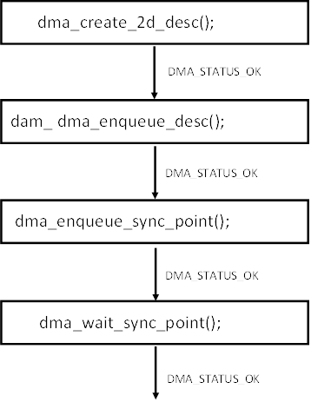
Basic Application
Basic Application
Initialization
Use the following functions to initialize the DDMA manager and queue:
dma_init_manager();
dma_allocate_queue(& g_queue_base, (unsigned int *)g_queue , 4, sizeof(g_queue ) / sizeof (dma_desc_t));
Workflow
Figure 2-1 shows the workflow of a basic application with the DDMA.
Figure 2-1: Basic Application Workflow
Confidential and Proprietary · Unauthorized Reproduction Prohibited
Copyright © 2016 – CEVA®, Inc.
3

Slide 12
CEVA-XM4™ DDMA User Guide
2.3 Code Example
Example 2-1 demonstrates a basic application code of a DDMA workflow.
Example 2-1: Basic Application Code
void transfer_2d()
{
unsigned int transfer_width = 49; unsigned int transfer_height = 20; unsigned int src_stride = 49; unsigned int dst_stride = 64; unsigned int src_offset = 1039; unsigned int dst_offset = 2043;
unsigned int sync_point_val; printf("Starting transfer_2d Test:\n");
//Create one dimension task descriptor
if (DMA_STATUS_OK != dma_create_2d_desc(&desc_2d, transfer_width, transfer_height, src_stride, dst_stride, DMA_DIR_EXTERNAL_INTERNAL, DMA_TYPE_LINEAR))
{
printf("Error creating 2d descriptor - Test failed!\n");
}
else
{
//enqueue task
if (DMA_STATUS_OK != dma_enqueue_desc(&myqueue_base,
&desc_2d, ext_buff + src_offset, int_buff+dst_offset))
{
printf("Error enqueuing 2d descriptor - Test
failed!\n");
}
else
{
4
Confidential and Proprietary · Unauthorized Reproduction Prohibited
Copyright © 2016 – CEVA®, Inc.

Slide 13
Basic Application
//Set sync point
if (DMA_STATUS_OK !=
dma_enqueue_sync_point(&myqueue_base, &sync_point_val))
{
printf("Error enqueuing sync point - Test
failed!\n");
}
else
{
//Poll on sync point dma_wait_sync_point(&myqueue_base,
sync_point_val);
printf("Test Passed\n");
}
}
}
}
Confidential and Proprietary · Unauthorized Reproduction Prohibited
Copyright © 2016 – CEVA®, Inc.
5

Slide 14
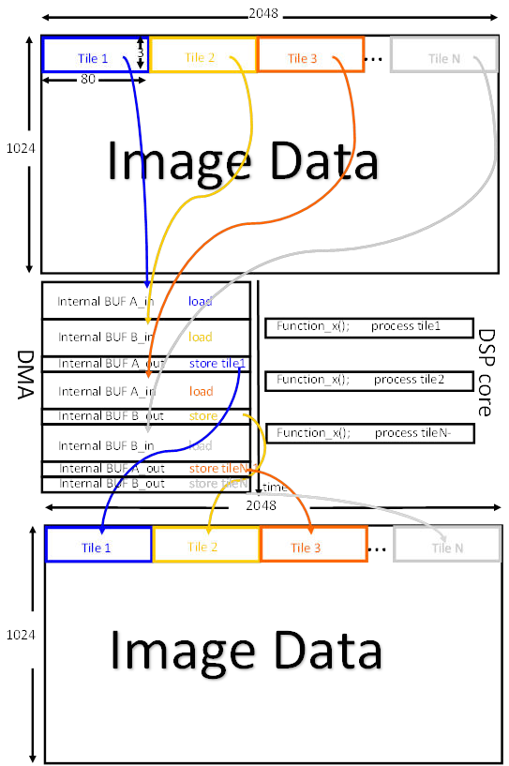
CEVA-XM4™ DDMA User Guide
2.4 Image Process
Figure 2-2 shows the DDMA algorithm optimization.
Figure 2-2: DDMA Algorithm Optimization
6
Confidential and Proprietary · Unauthorized Reproduction Prohibited
Copyright © 2016 – CEVA®, Inc.

Slide 15
Basic Application
Example 2-2 demonstrates the code for a PingPang buffer with the DDMA.
Example 2-2: Image Process Code
void Img_process_with_DMA_demo()
{
unsigned char ext_buf[EXT_BUF_SIZE]; unsigned char buf_A_in[BUF_SIZE]; unsigned char buf_A_out[BUF_SIZE]; unsigned char buf_B_in[BUF_SIZE]; unsigned char buf_B_out[BUF_SIZE];
unsigned char*p_buf_src[2] = { buf_A_in, buf_B_in }; unsigned char*p_buf_dst[2] = { buf_A_out, buf_B_out };
//Create task descriptor
dma_create_desc(&desc_2d, transfer_width, transfer_height, src_stride, dst_stride, DMA_DIR_EXTERNAL_INTERNAL, DMA_TYPE_LINEAR))
for (i = 0; i < row_loop; i += row_step)
{
for (j = 0; j < line_loop; j += line_step)
{
//DMA process dma_enqueue_desc(&myqueue_base, &desc_2d,
p_buf_src[], p_buf_dst[phase ^ 1]);
dma_enqueue_sync_point(&myqueue_base,
&sync_point_val[phase^ 1]););
//DSP core process dma_wait_sync_point(&myqueue_base,
sync_point_val[phase]);
process(buffer[[phase])]); phase ^= 1;
}
}
}
Confidential and Proprietary · Unauthorized Reproduction Prohibited
Copyright © 2016 – CEVA®, Inc.
7

